Slide 1
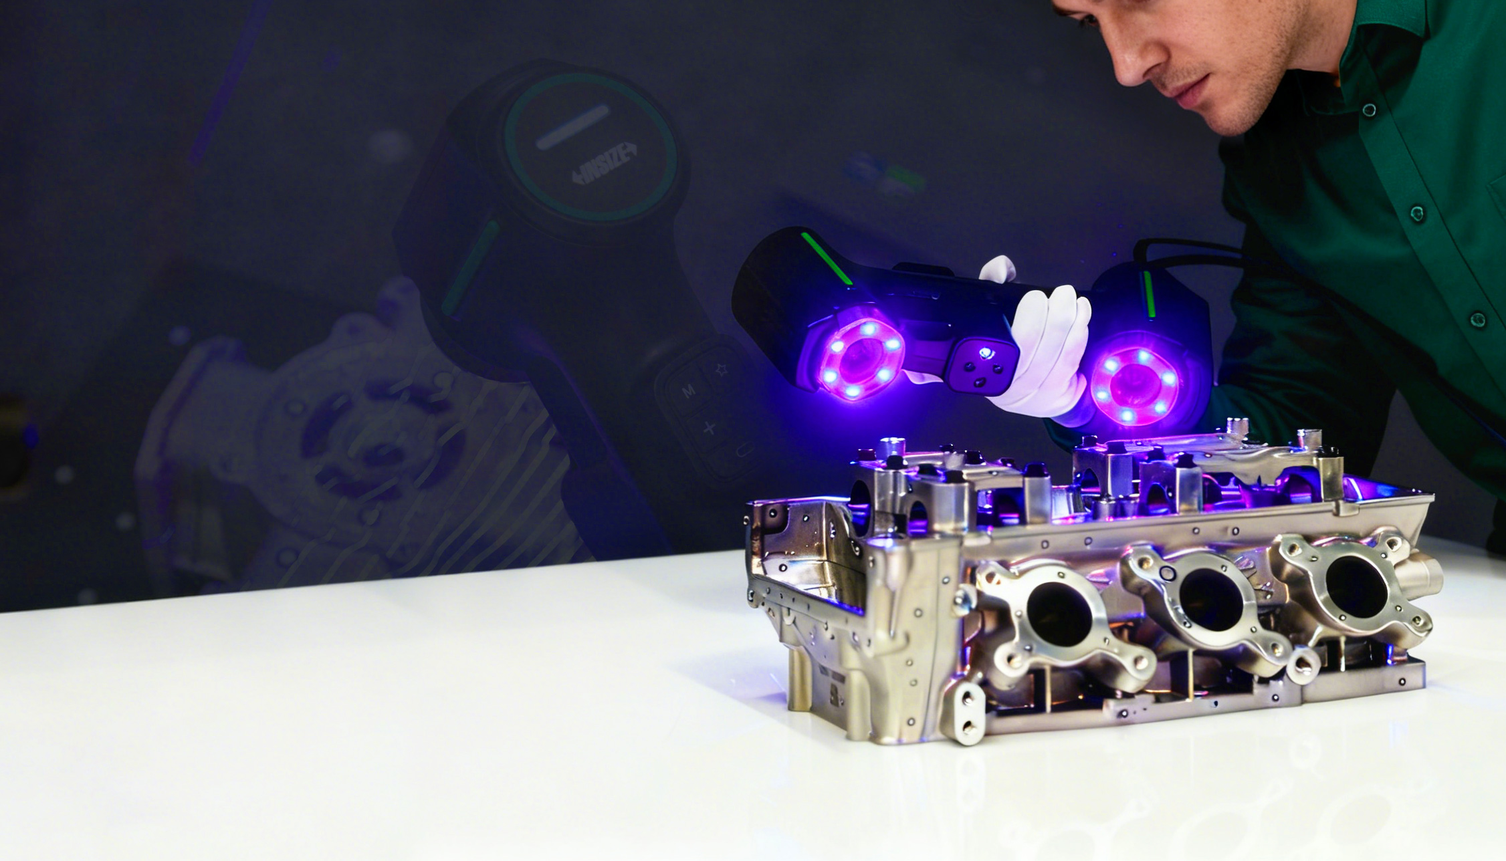
INSIZE
Quality Innovation Service Value
Metal
Machining
Inspection
INSIZE INDIA LLP
www.insize.in
V.1 05.2026

Slide 2
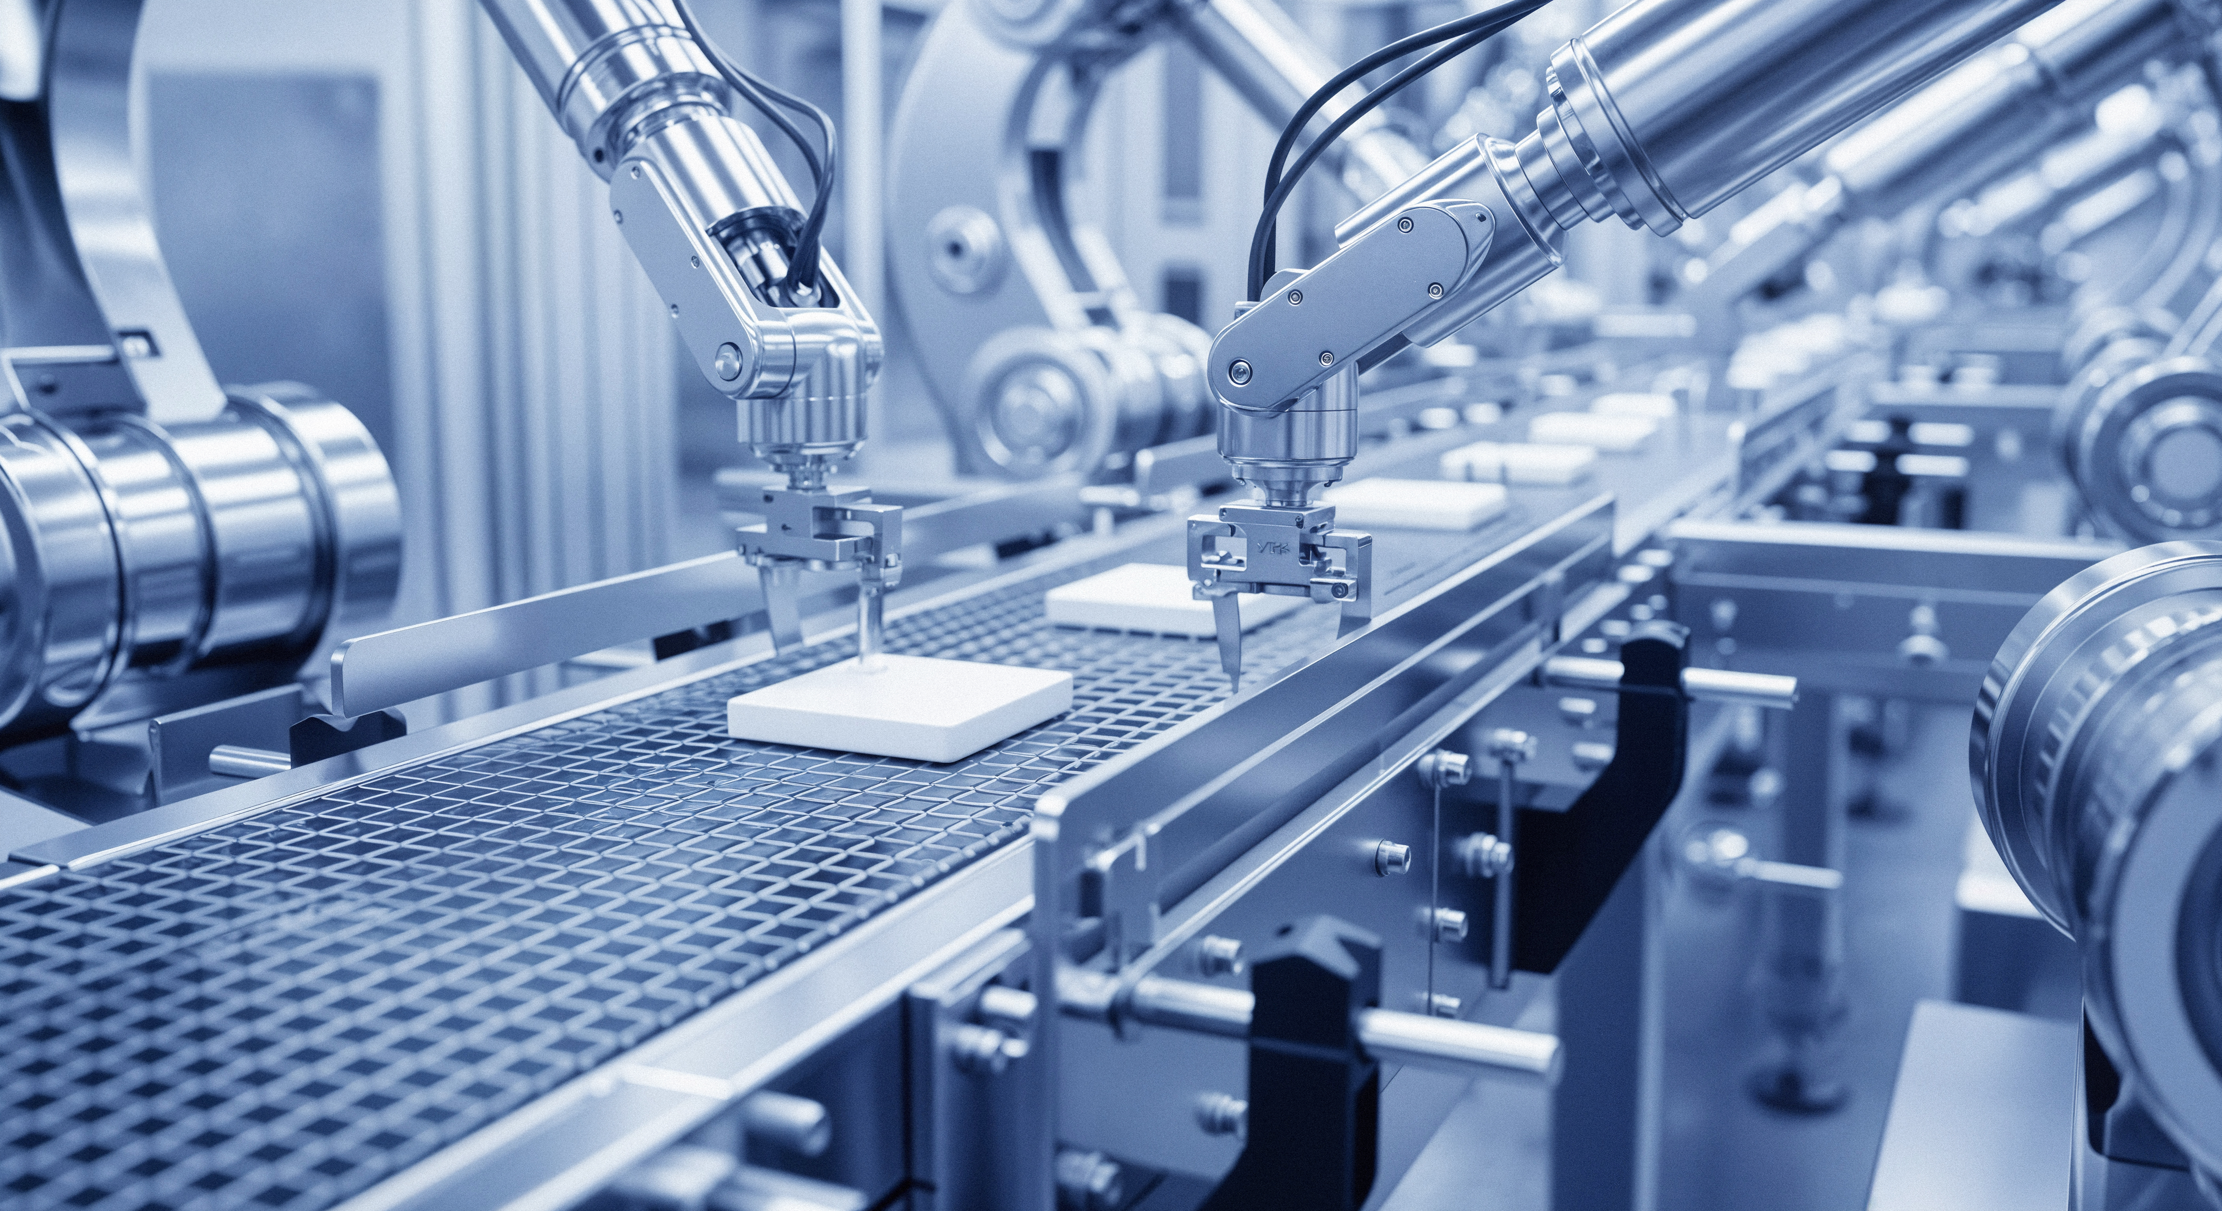

CONTENTS
01 Dimensional Measurement (Measuring Tools)
02 Dimensional Measurement (Measuring Instruments)
03 Surface Inspection
04 Cleanliness Testing
05 Roughness Measurement
06 Hardness Testing
07 Metallographic Inspection
08 Component Analysis
09 Flaw Detection Testing
10 Mechanical Testing
11 Coating/Plating Thickness Measurement
12 Coating Property Testing
13 Gloss/Color Testing
14 Reliability Testing

Slide 3

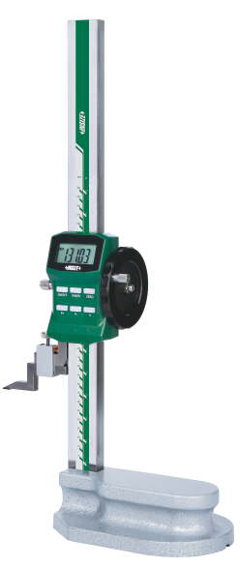
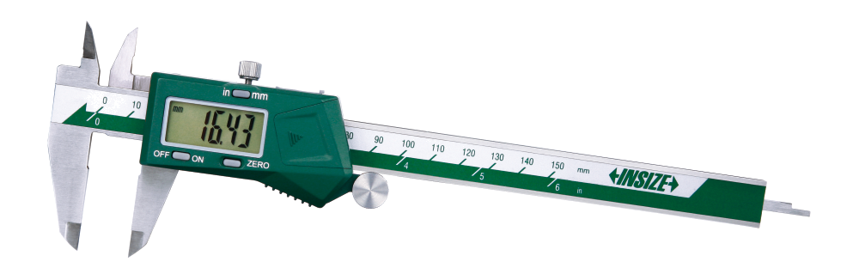
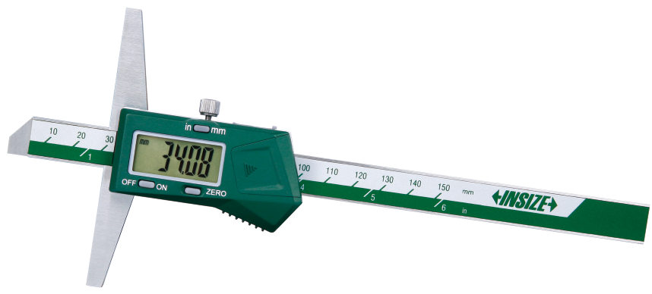
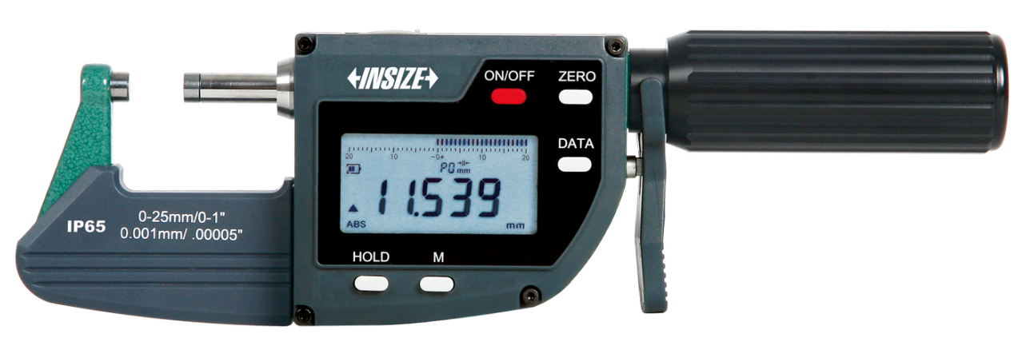
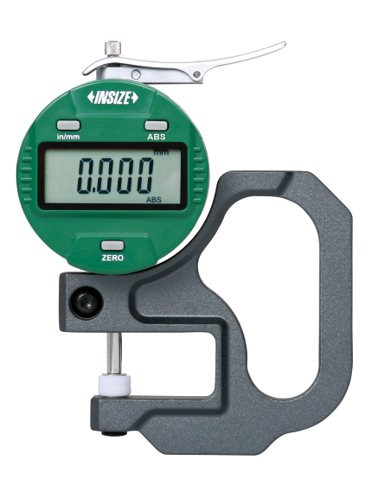
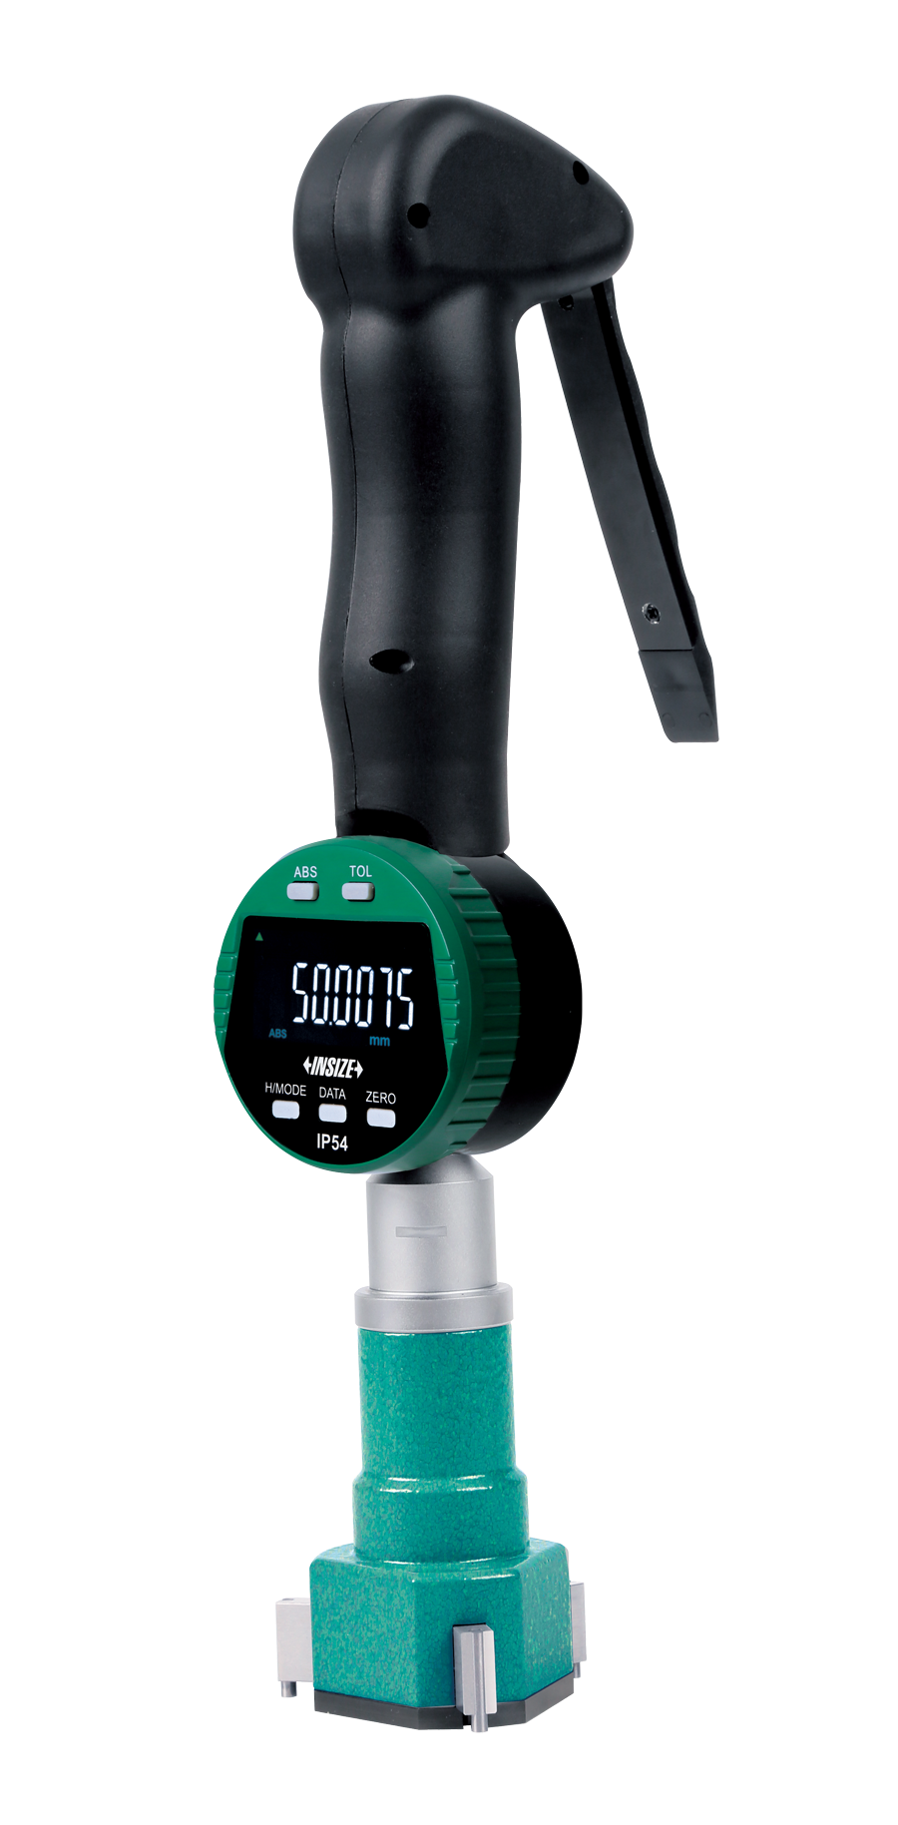
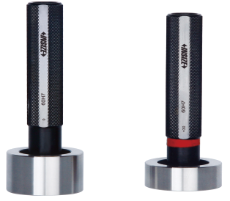
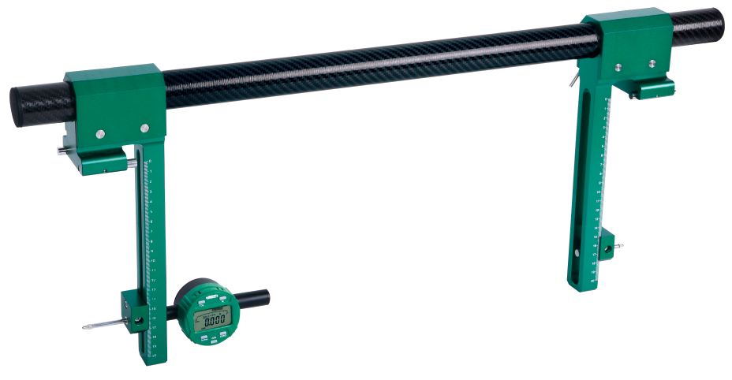
01
Dimensional Measurement (Measuring Tools P1)
Digital Calipers
Digital Micrometers
Digital Depth Gauges
Digital Height Gauges
Digital Thickness Gauges
Three Points Bore Gauges
Comparison Gauges
Plug Gauges

Slide 4
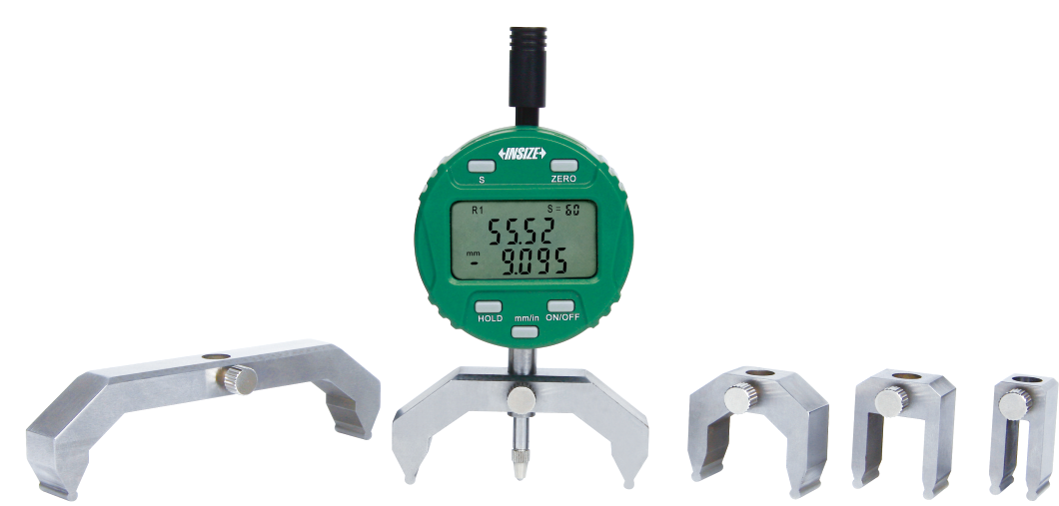
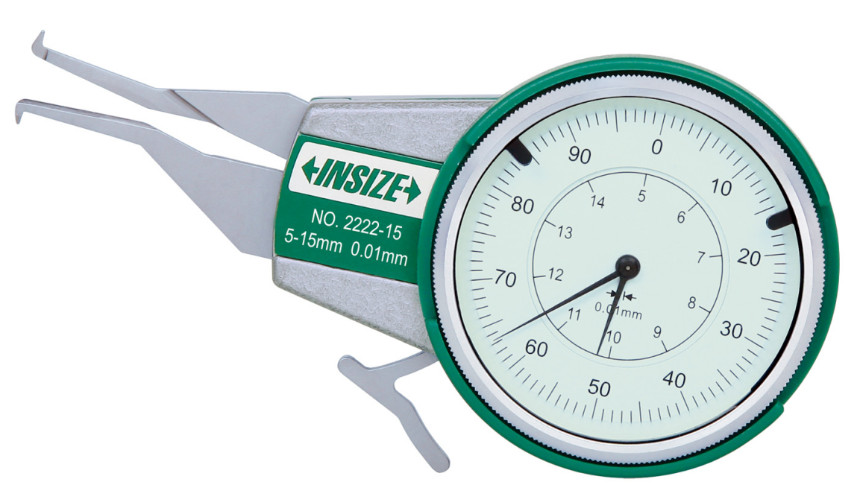
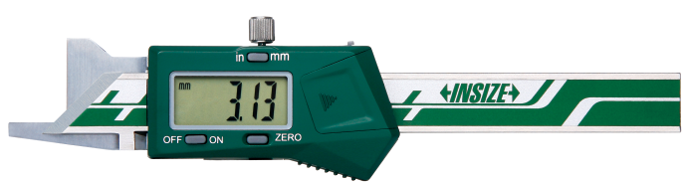
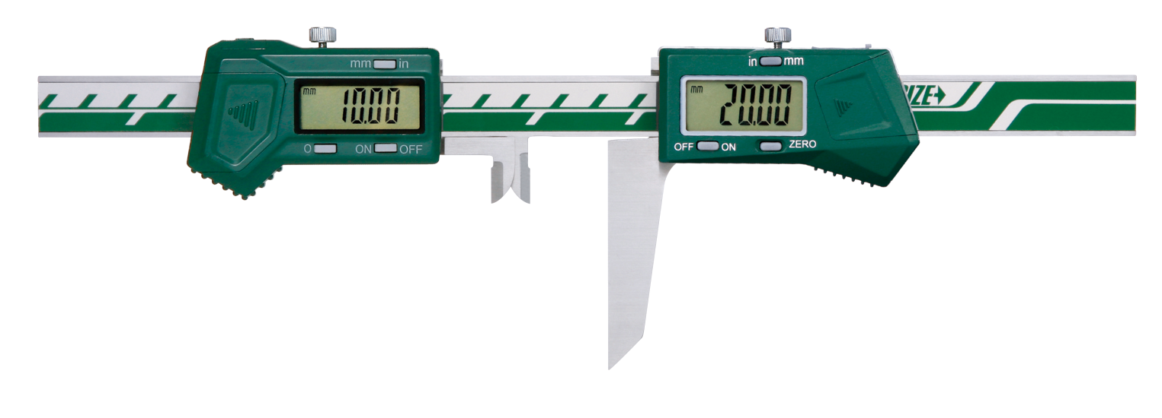
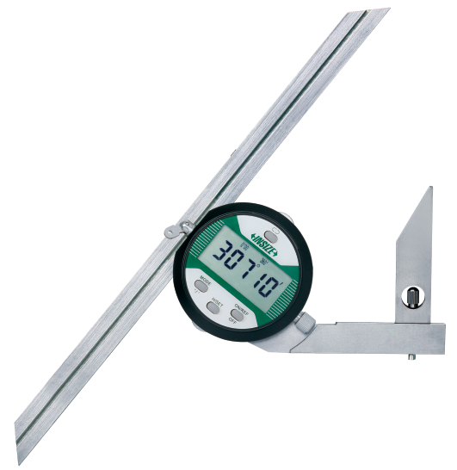
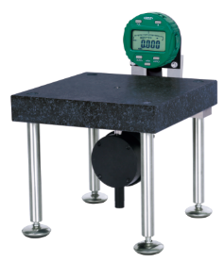
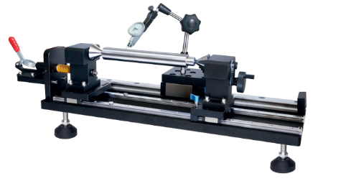
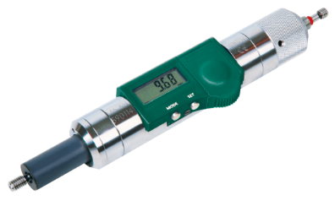
01
Dimensional Measurement (Measuring Tools P2)
数显半径规
Internal Caliper Gauges
Keyway Symmetry Digital Calipers
Digital Chamfer Gauges
Digital Radius Gauges
数显内卡规
键槽量具
Digital Protractors
Digital Thread Depth Gauges
Flatness Measurement Stands
Bench Centers

Slide 5
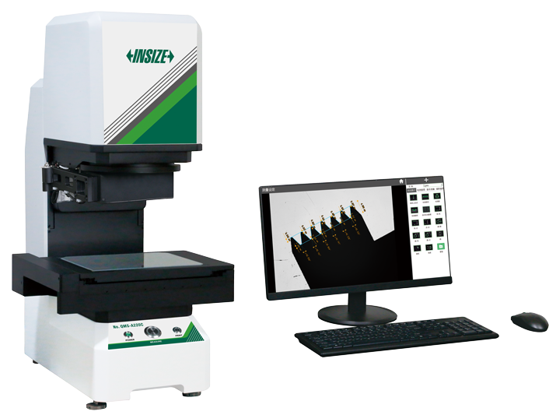
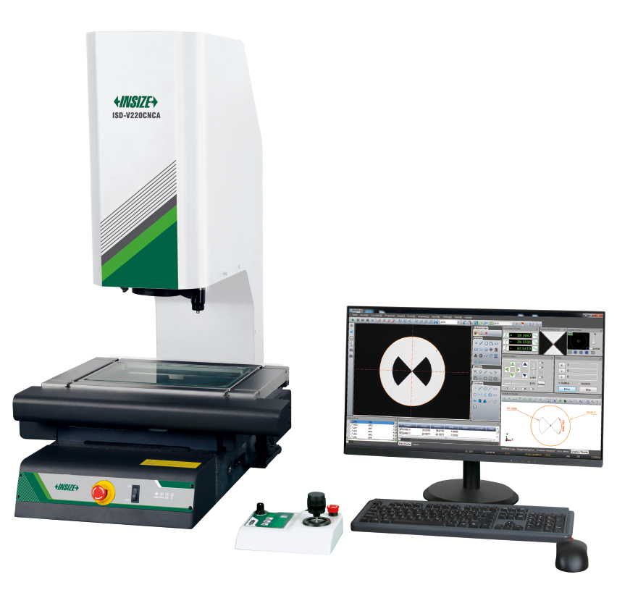
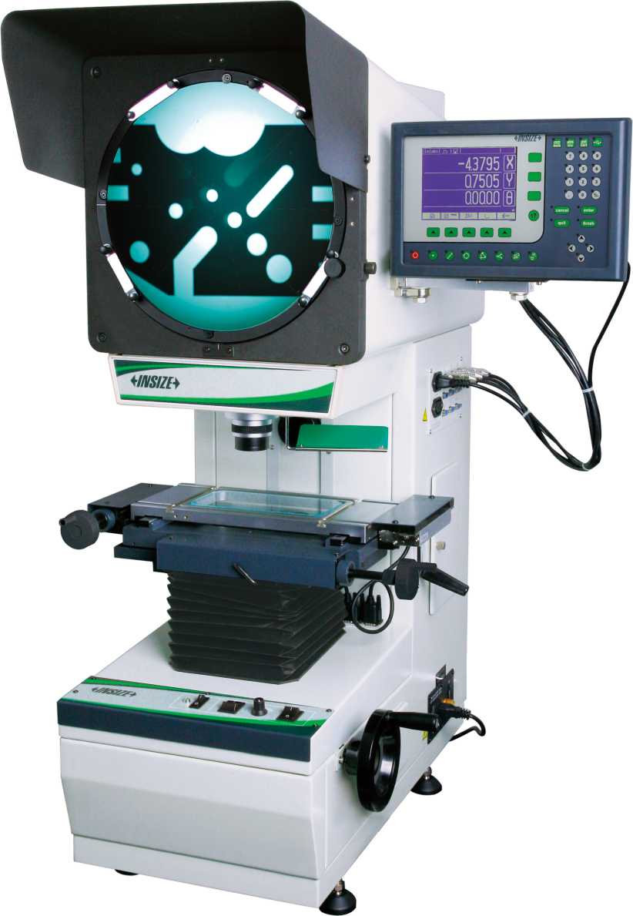
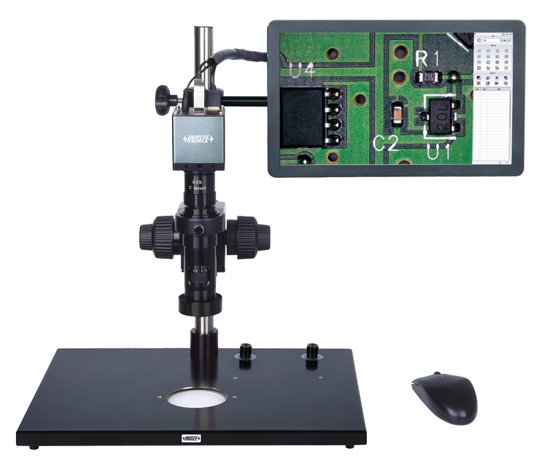
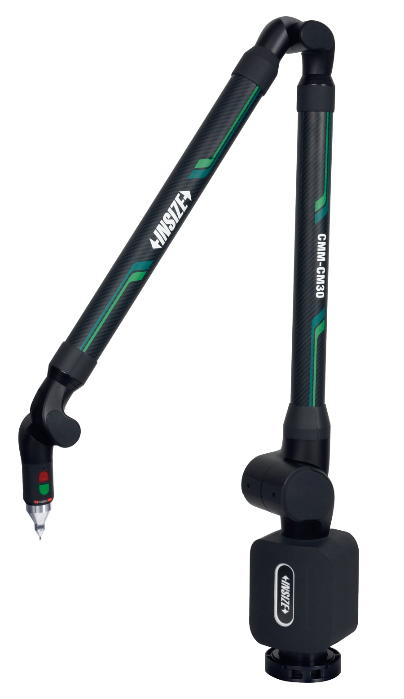
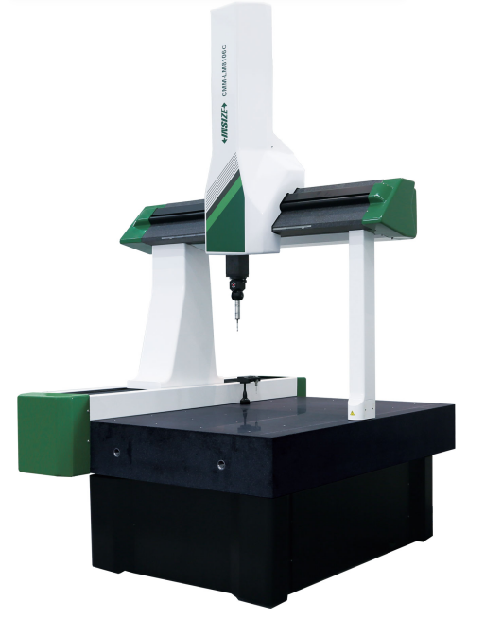
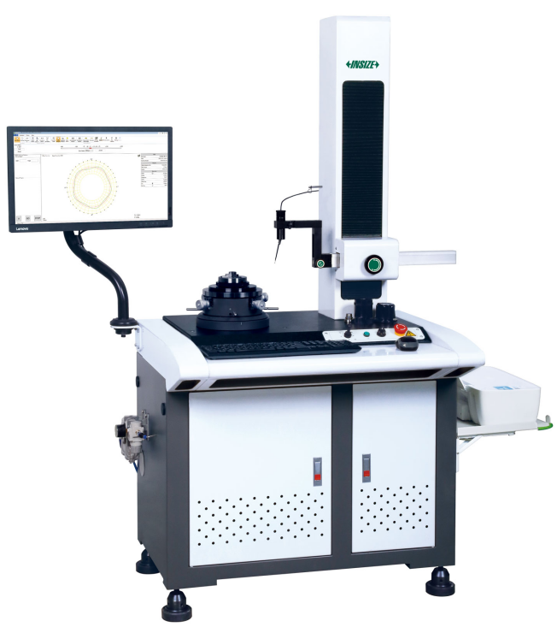
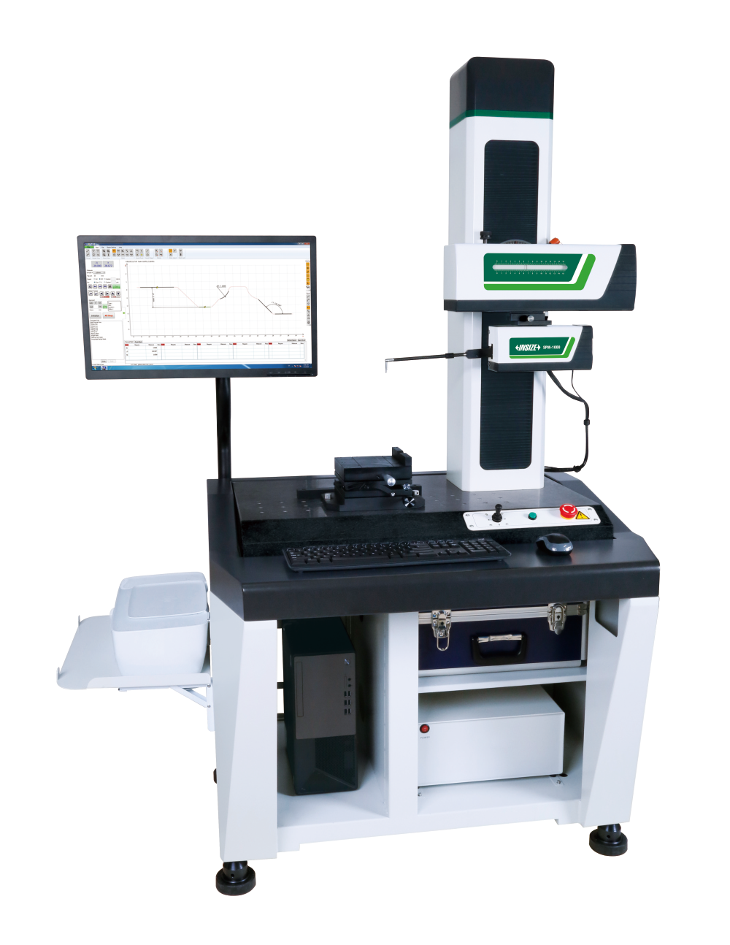
02
Dimensional Measurement (Measuring Instruments P1)
Quick Measurement Systems
CNC Vision Measuring Systems
Profile Projectors
Digital Measuring Microscopes
Coordinate Measuring Machines
Surface Profile Measuring Machines
Measuring Arms
Roundness Measuring Machines

Slide 6
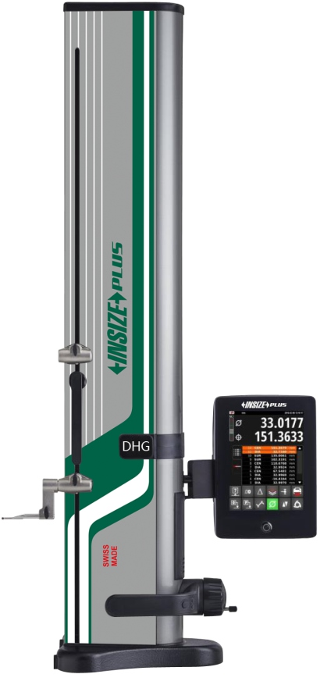
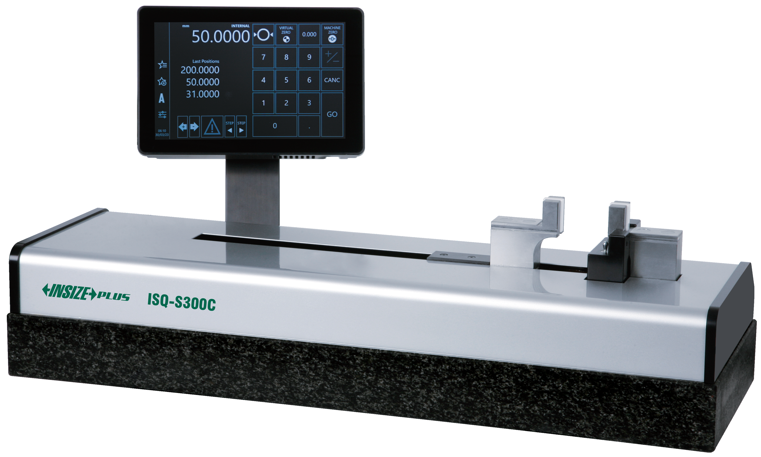
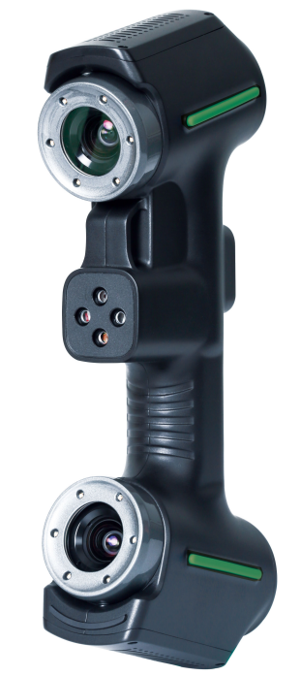
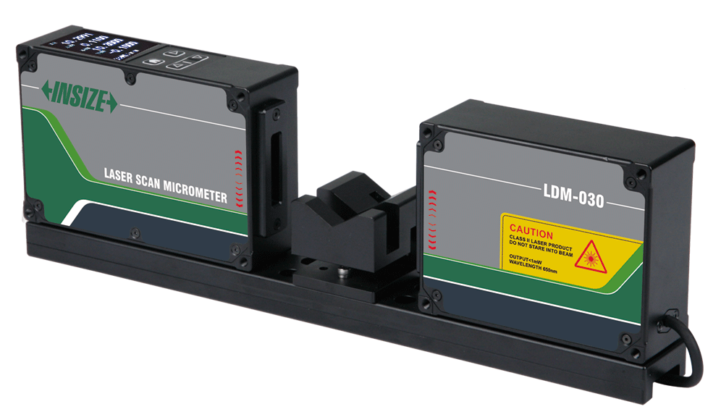
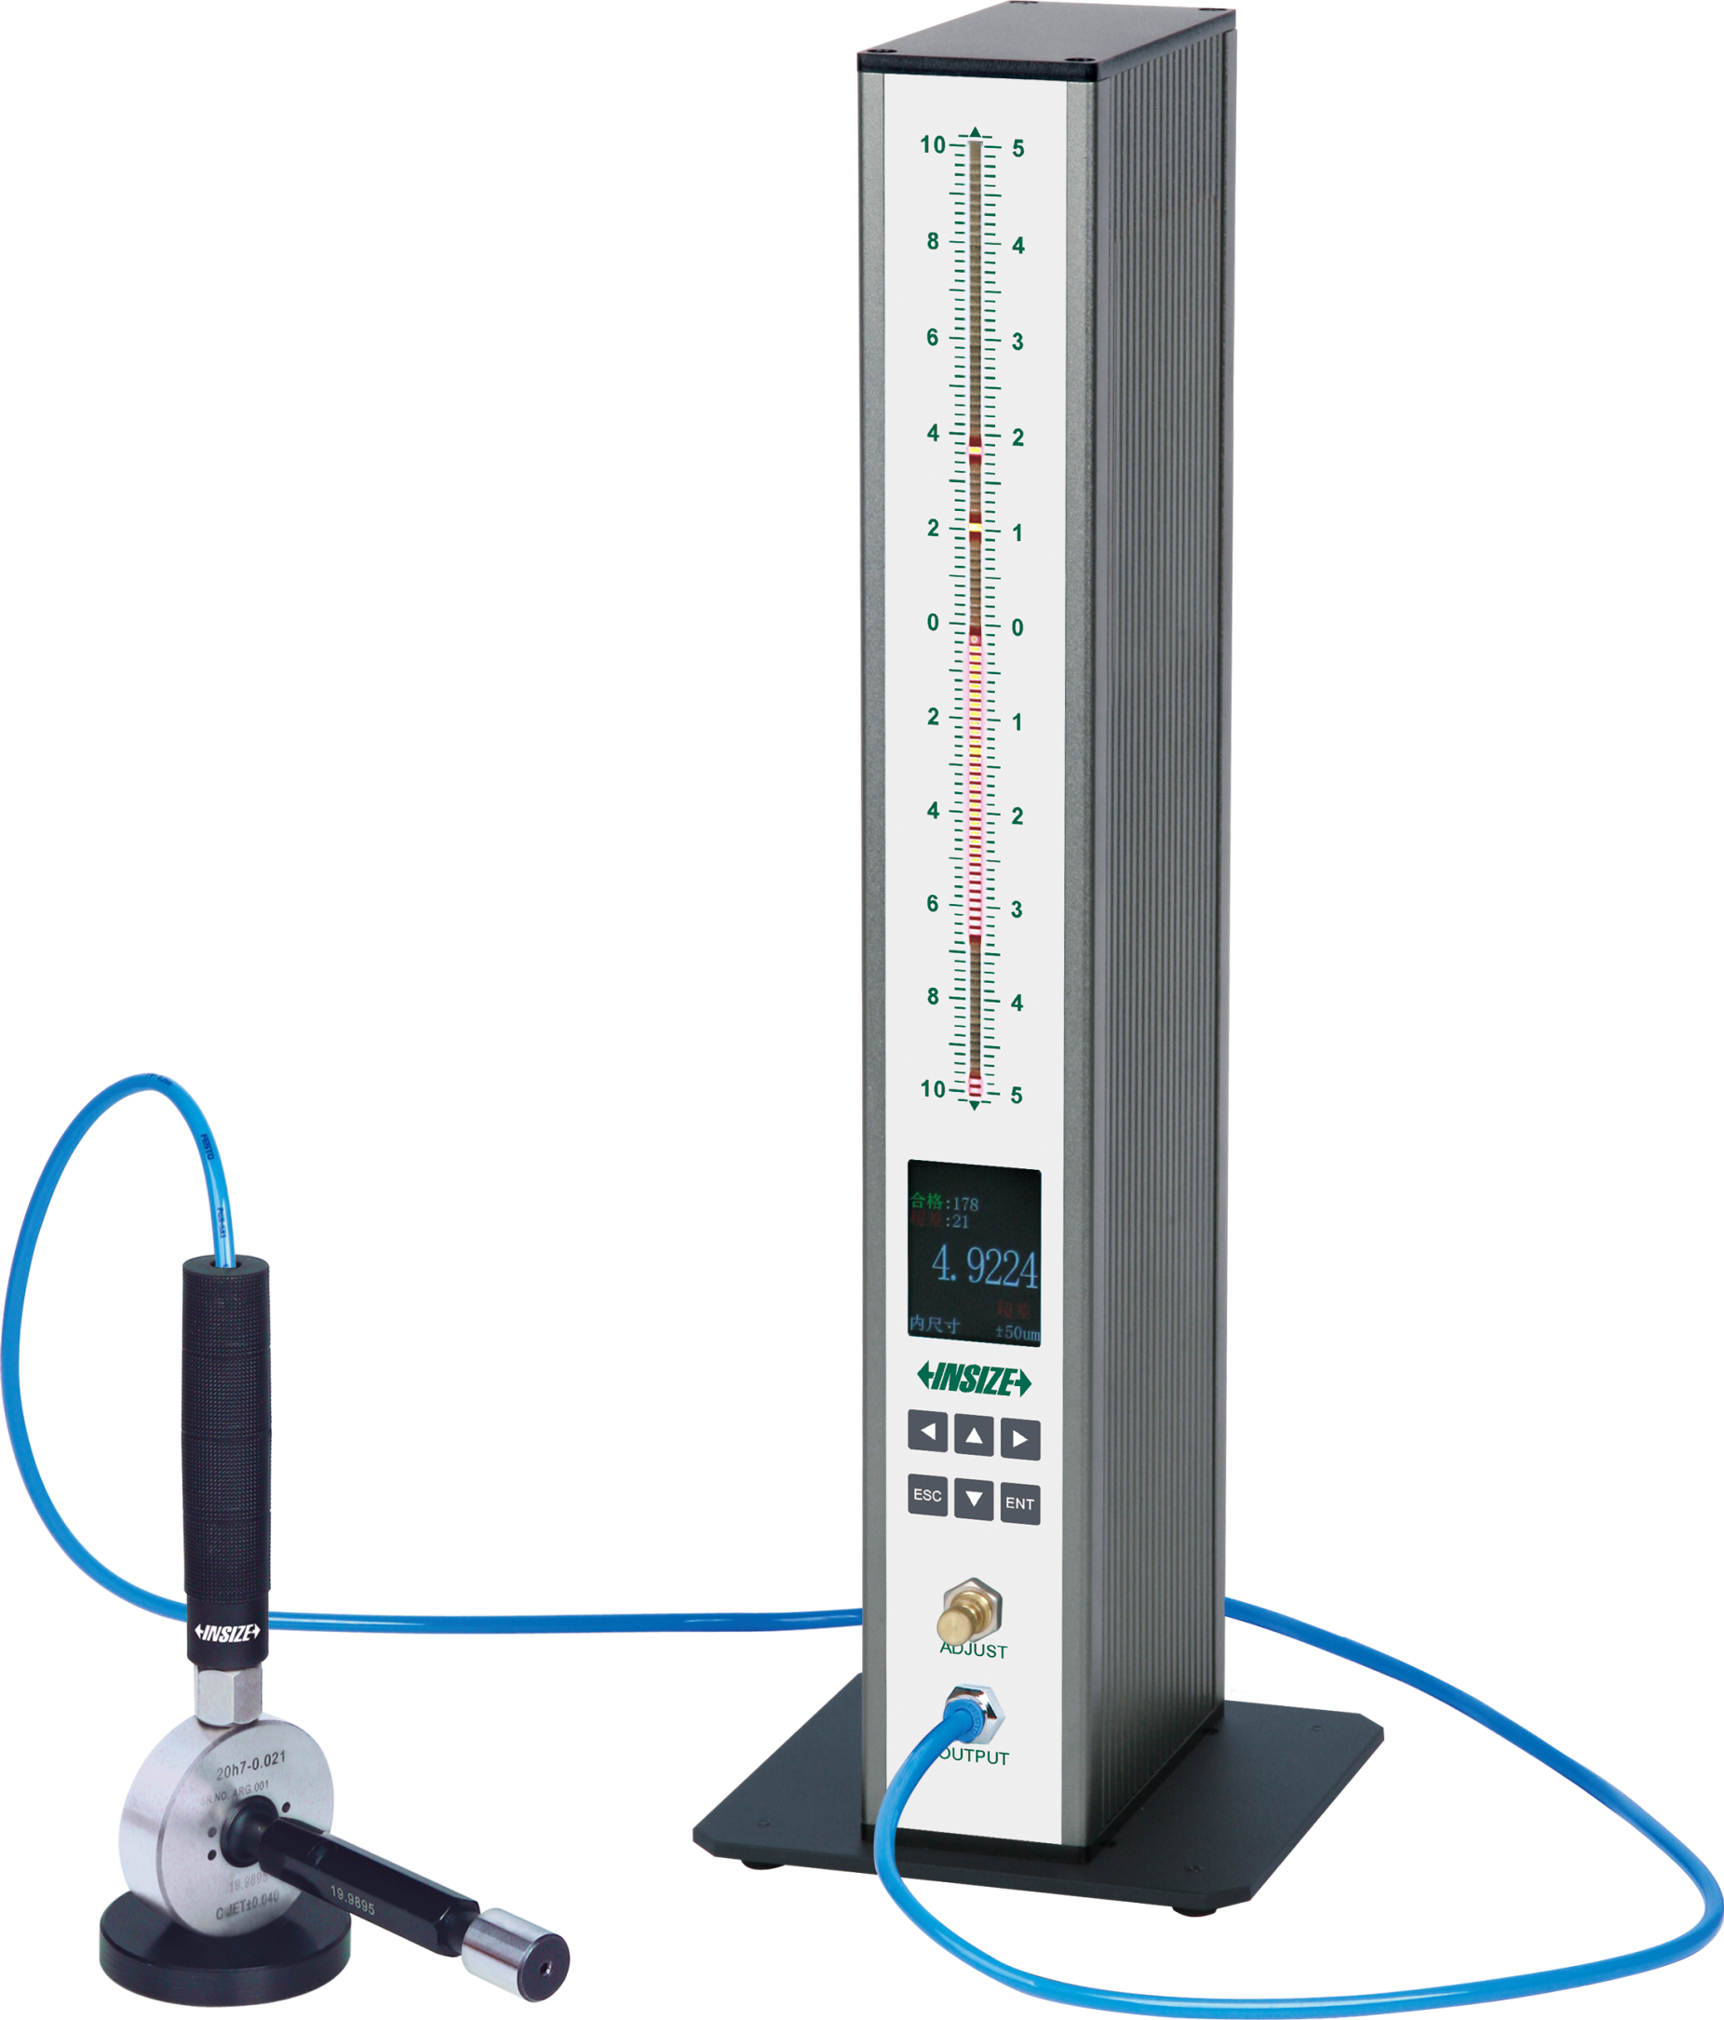
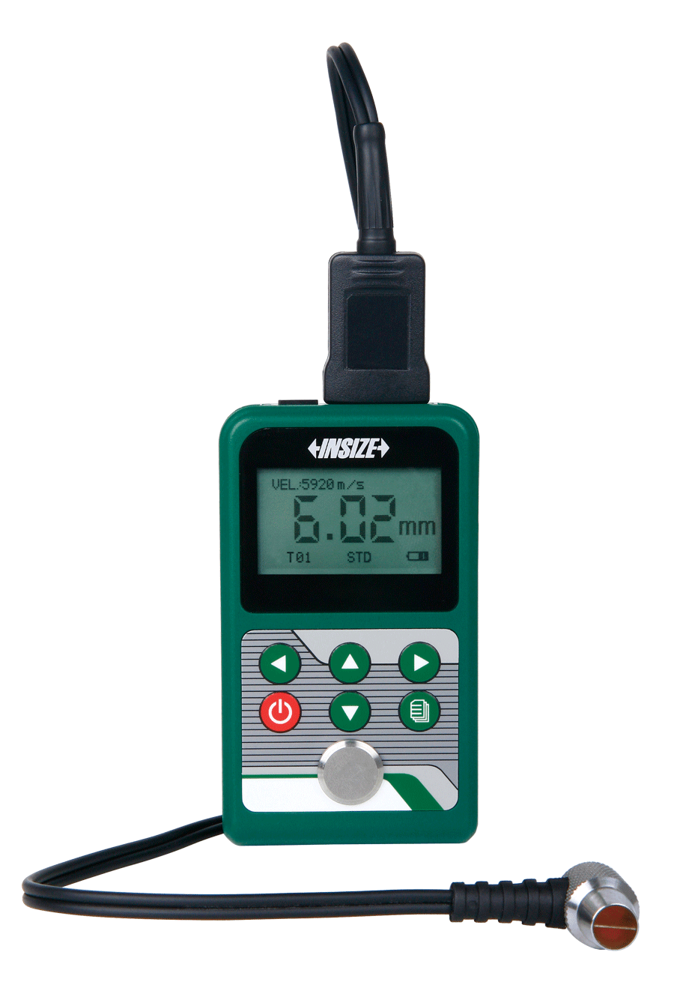
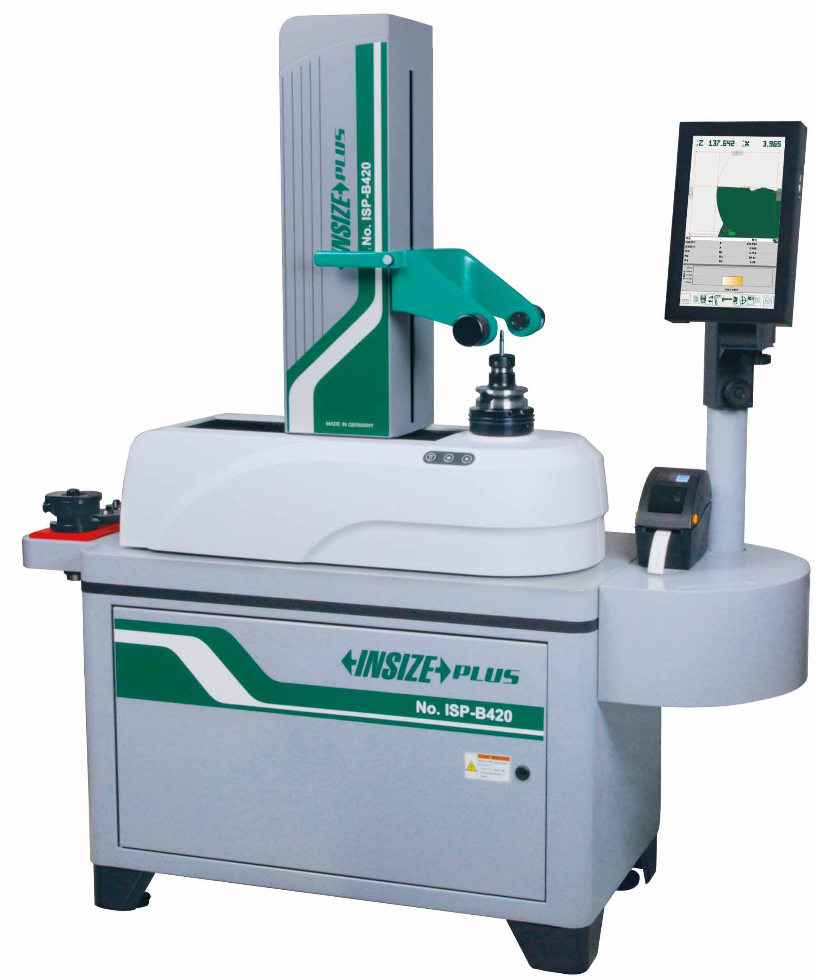
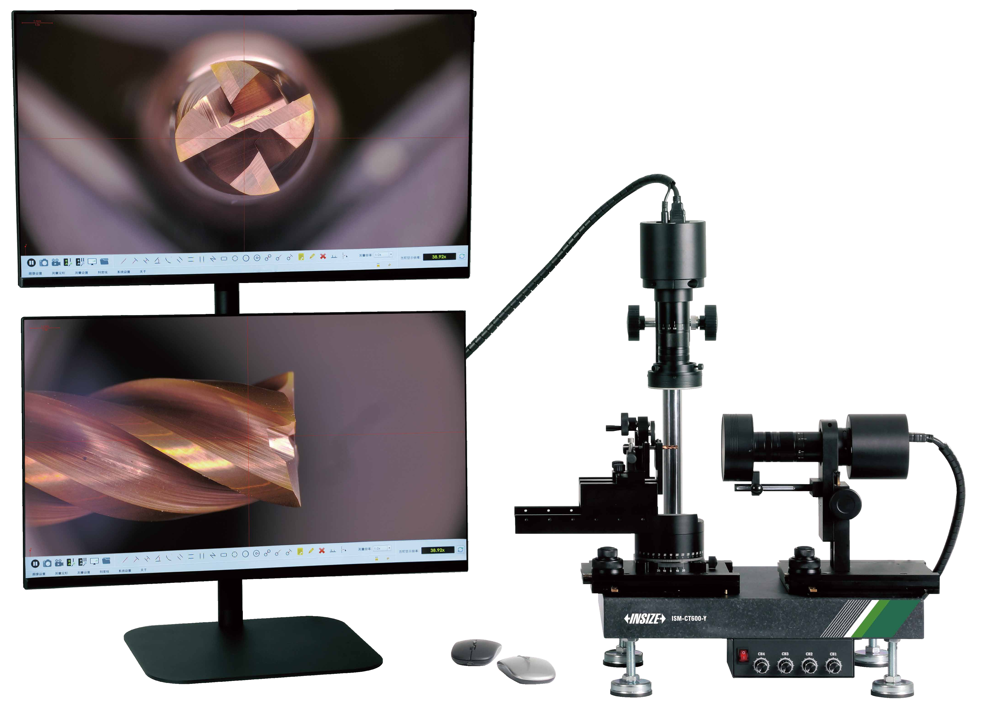
02
Dimensional Measurement (Measuring Instruments P2)
Height Gauges
Length Presetters
Handheld 3D Scanners
Laser Scan Micrometers
Dual-Display Cutting Tools
Microscopes
Air Gauges And Displays
Ultrasonic Thickness Gauges
Tool Presetters

Slide 7
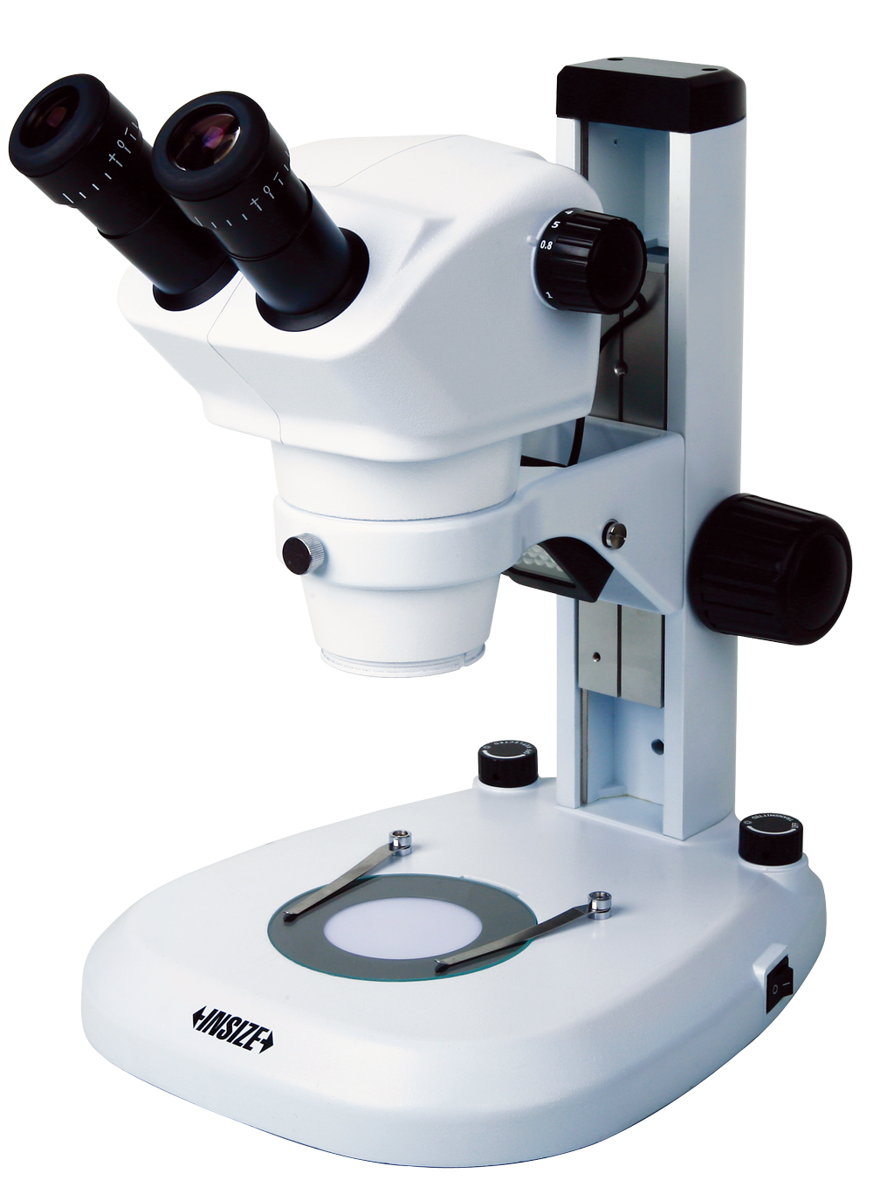
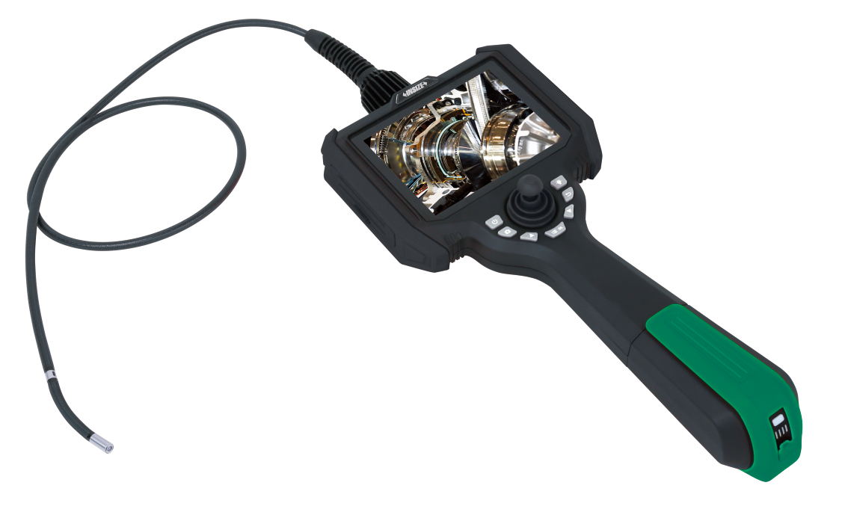
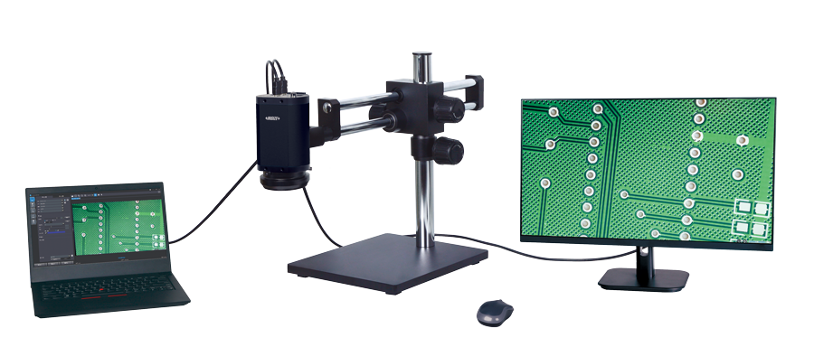
03
Surface Inspection
Zoom Stereo Microscopes
Auto Focus Digital Microscopes
Videoscopes

Slide 8
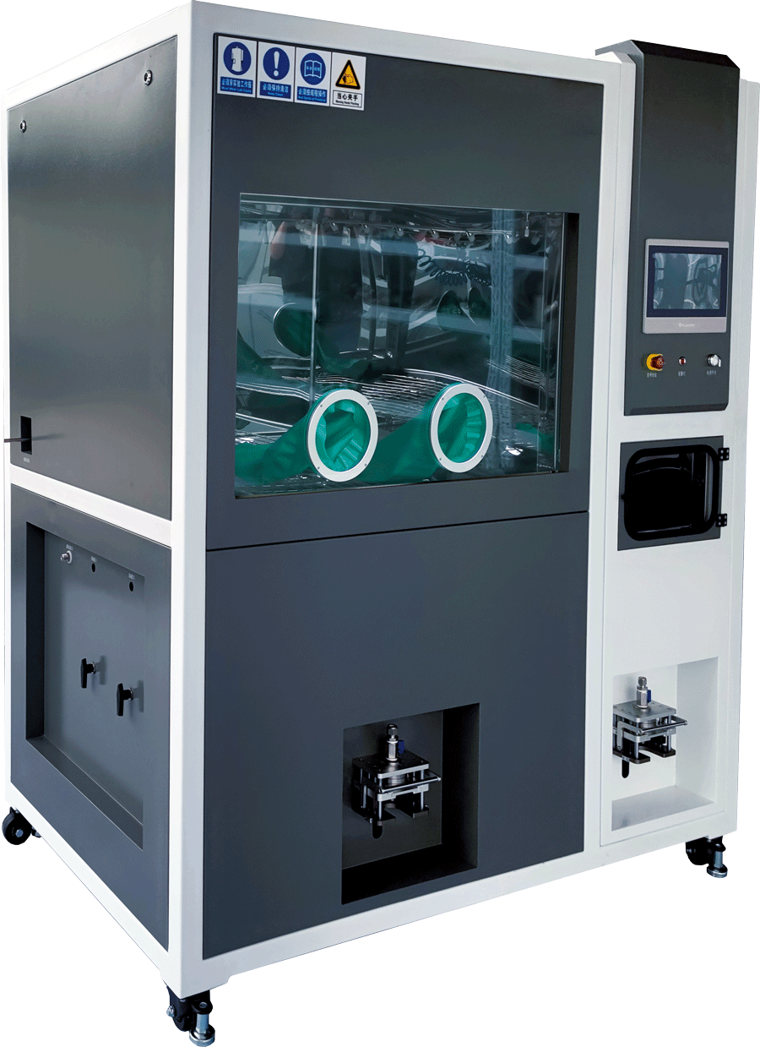
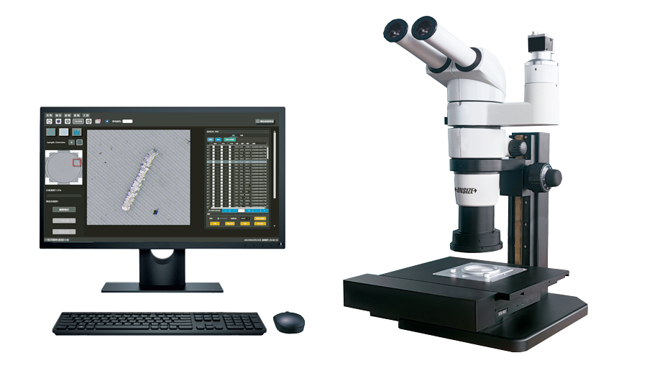
04
Cleanliness Testing
Parts Cleanliness Testing Cabinets
Automatic Cleanliness Analysis Systems

Slide 9
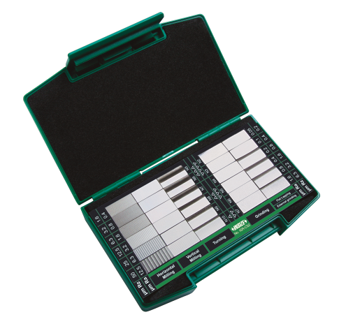
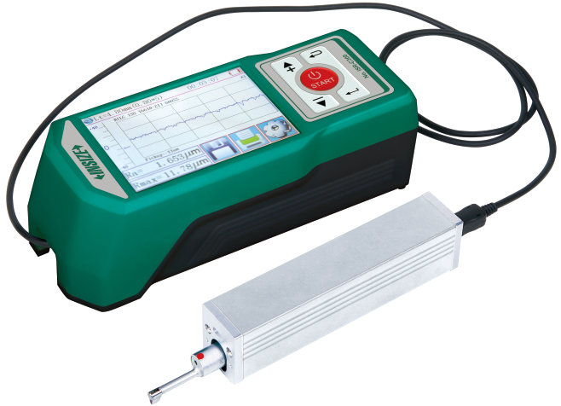
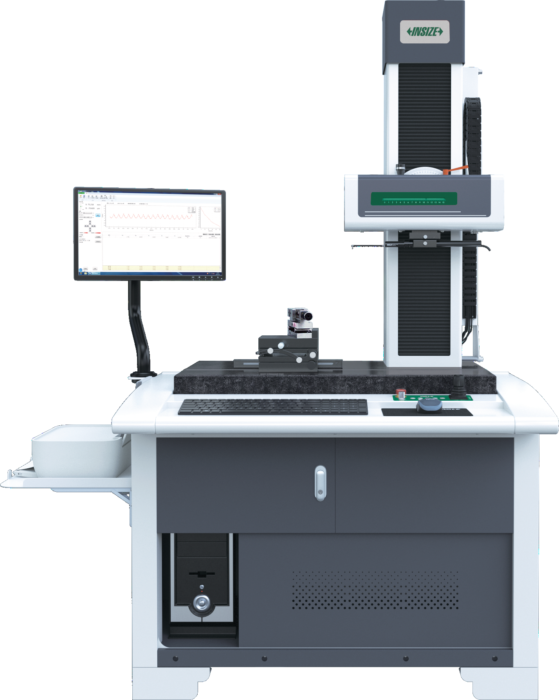
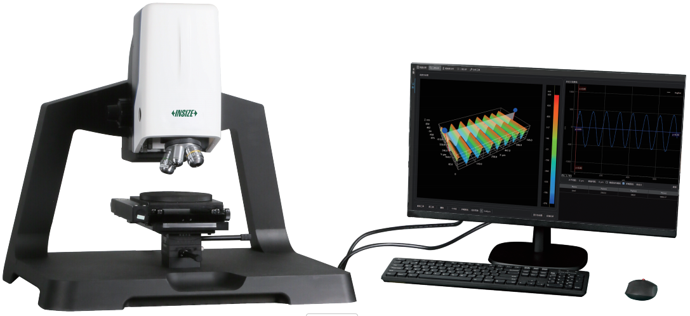
05
Roughness Measurement
Surface Roughness Specimen Sets
Roughness Testers
White Light Interference Measuring Microscopes
Roughness Measuring Machines

Slide 10
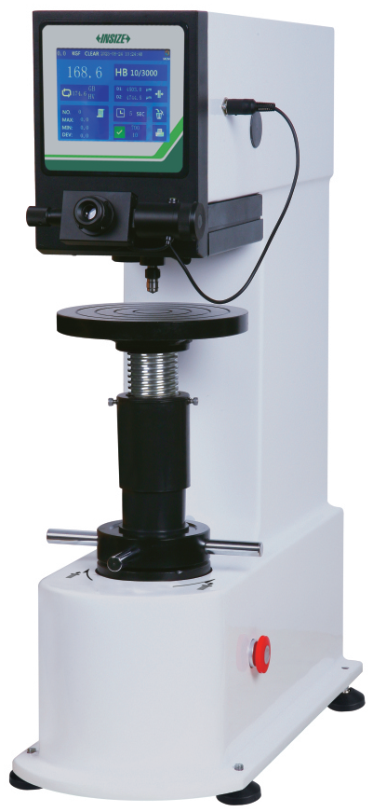
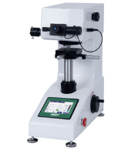
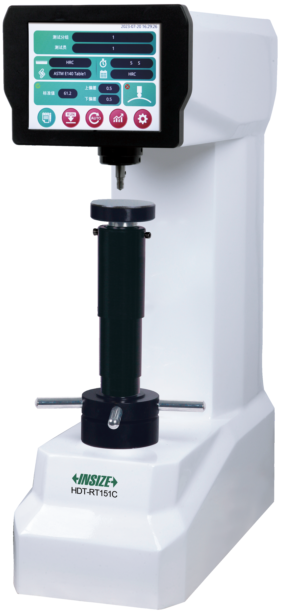
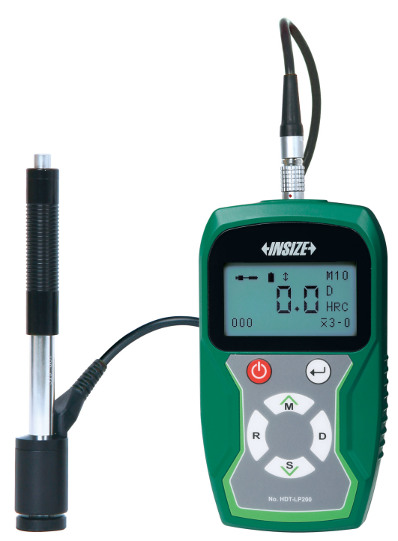
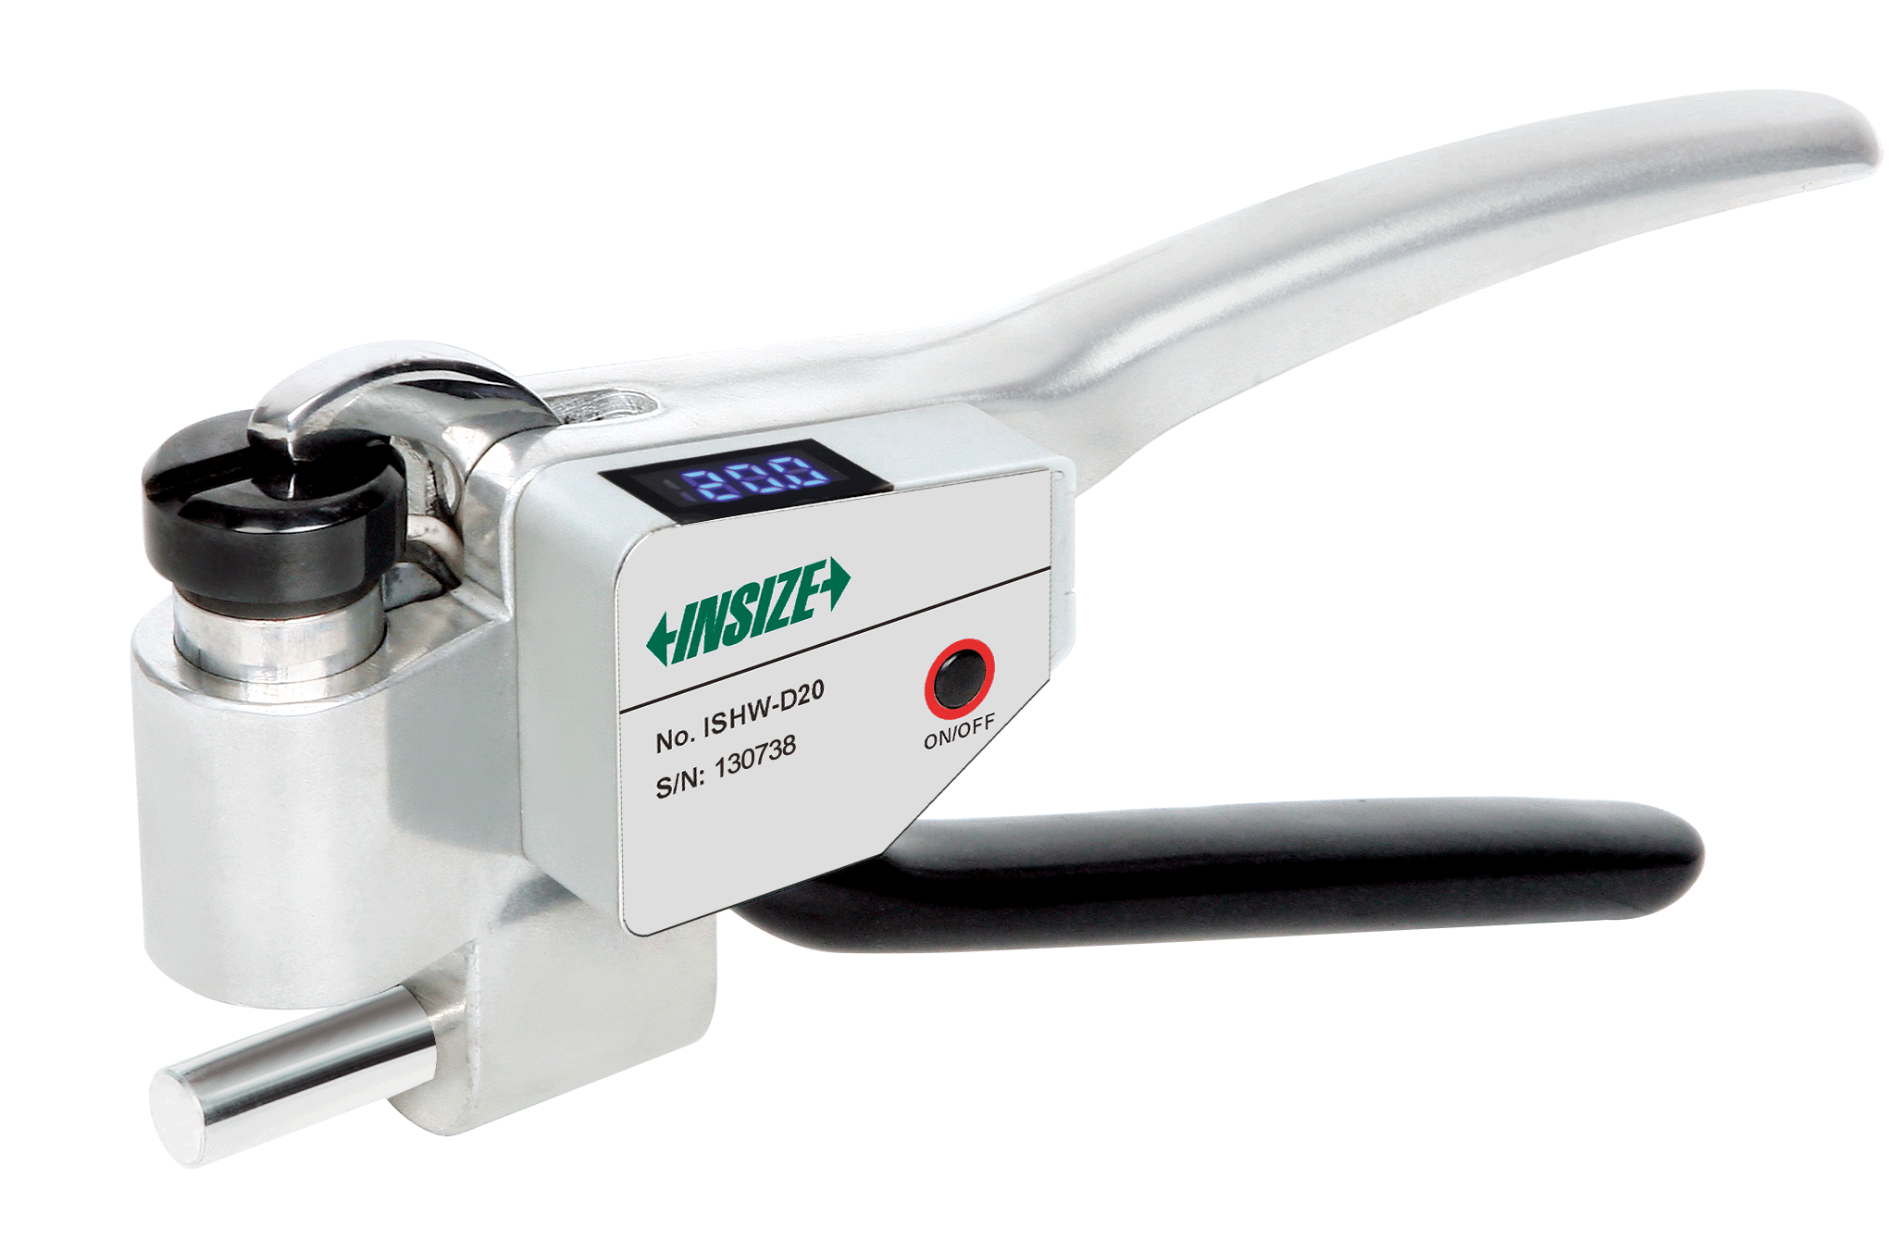
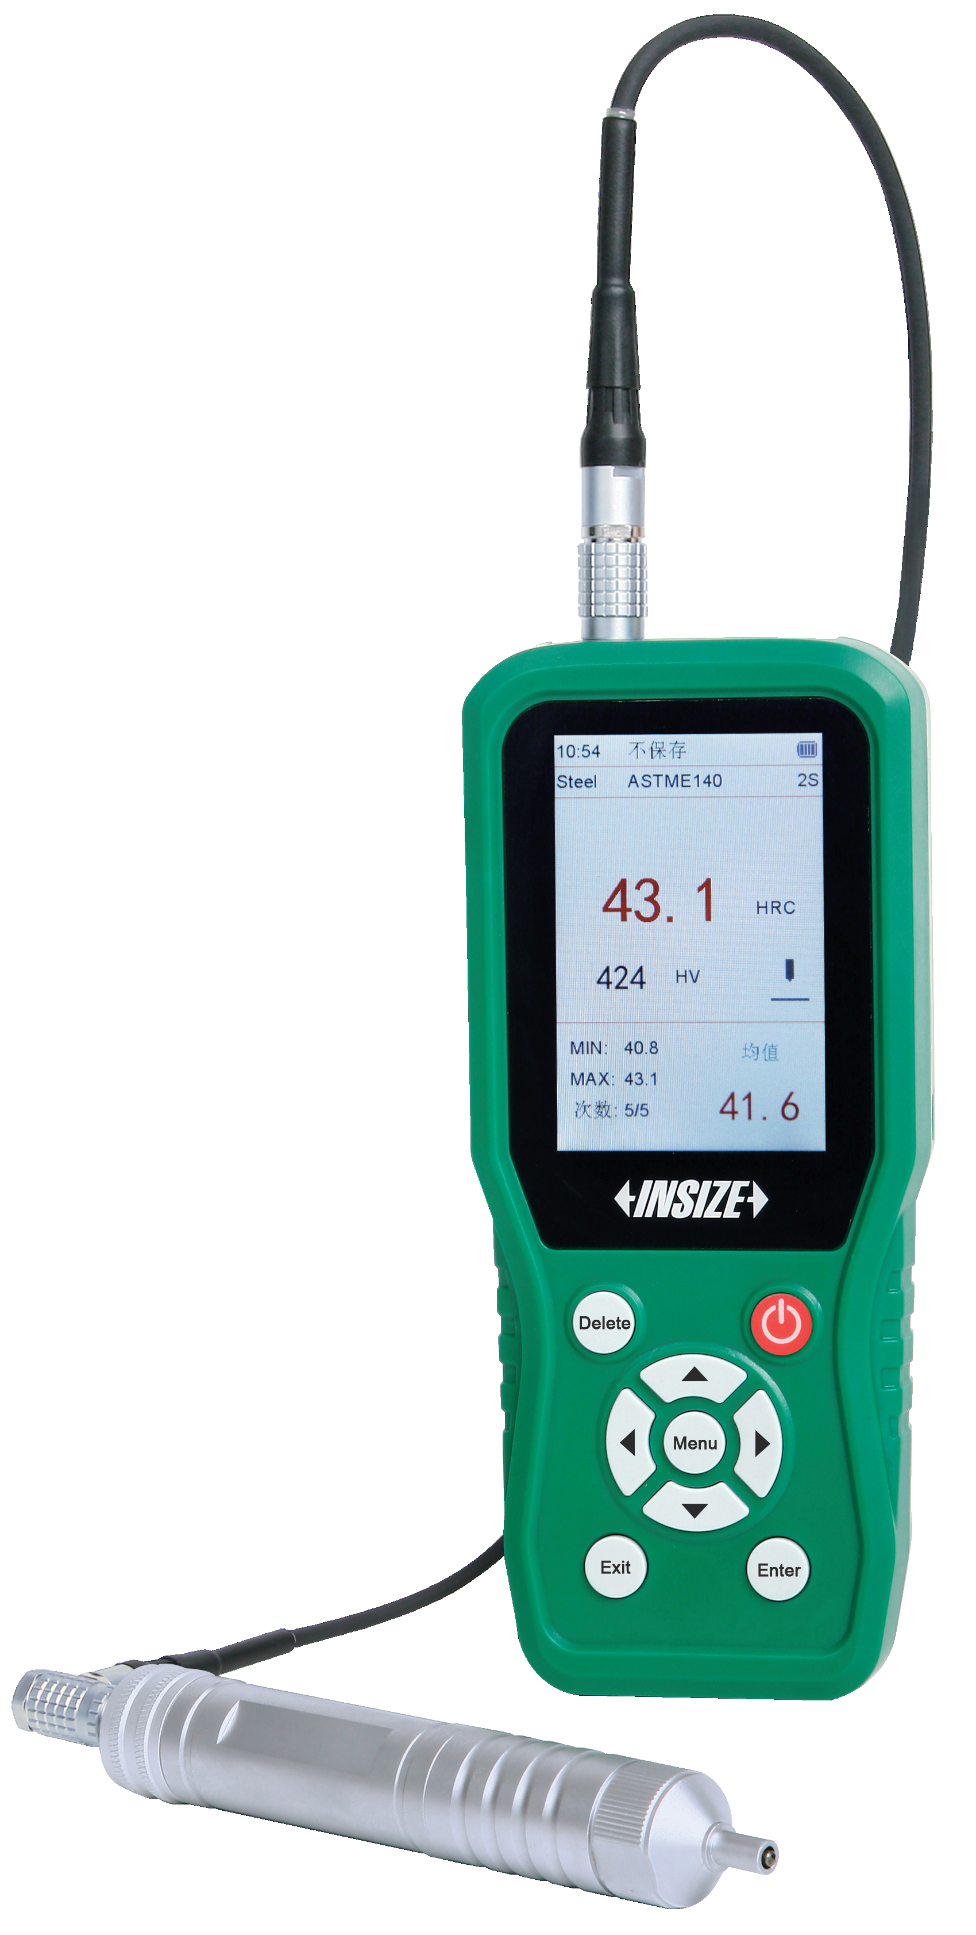
06
Hardness Testing
Brinell Hardness Testers
Vickers Hardness Testers
Rockwell Hardness Testers
Leeb Hardness Testers
Aluminum Hardness Testers
Ultrasonic Hardness Testers

Slide 11
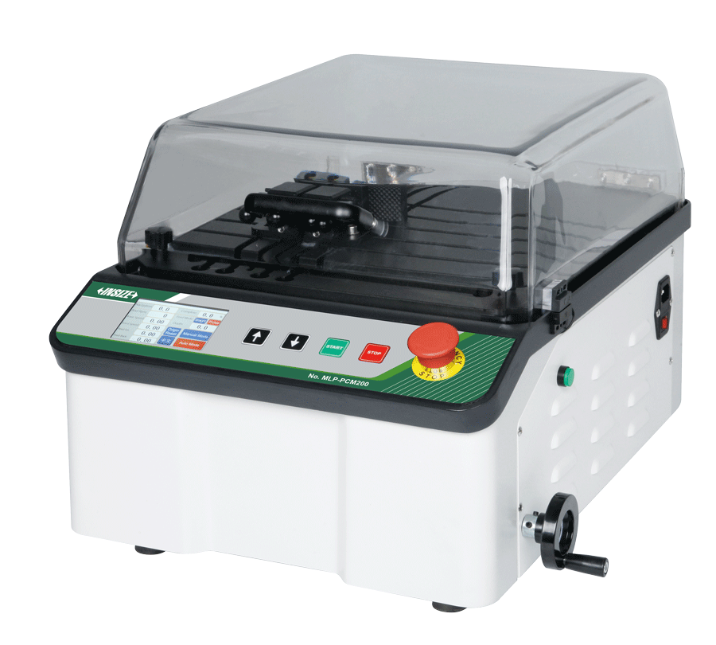





07
Metallographic Inspection
Automatic Precision Cutting Machines
Automatic Grinder And Polishers
Mounting Presses
Metallurgical Analysis Software And Cameras
Metallurgical Microscopes
Metallurgical Microscopes

Slide 12






08
Component Analysis
Spark Direct Reading Spectrometers
Handheld XRF Alloy Analyzers
Handheld Libs Spectrometers
Oxygen/Nitrogen/Hydrogen Analyzers
RoHS Analyzers
Carbon And Sulfur Analyzers

Slide 13






09
Flaw Detection Testing
Magnetic Powder Flaw Detectors
Eddy Current Flaw Detectors
Ultrasonic Flaw Detectors
UV/White Light Flaw Detection Lights
Ultrasonic Water Immersion Detection Systems
Fluorescent Penetrant Fluids

Slide 14






10
Mechanical Testing
Electronic Universal Testing Machines
Electronic Torsion Testing Machines
Impact Testing Machines
Vertical Bending Testing Machines
Servohydraulic Fatigue Testing Machines
Manual Spring Testing Machines

Slide 15



11
Coating/Plating Thickness Measurement
XRF Plating Thickness Instruments
Coating/Film Thickness Measurement Systems
Coating Thickness Gauges

Slide 16






12
Coating Property Testing
Automatic Pencil Hardness Testers
Rotational Abrasion Testers
Adhesion Testers
Cross Cut Adhesion Testers
Impact Testers
Paint Film Flexibility Testers

Slide 17



13
Gloss/Color Testing
Gloss Meters
Colorimeters
Spectrophotometers

Slide 18



14
Reliability Testing
Temperature And Humidity Chambers
Thermal Shock Test Chambers
Salt Spray Test Chambers

